Slide 1
DeepHeart Integration with MONAI Label
Christian Herz, Matthew Jolley, Danielle F. Pace, Andras Lasso, John Witt, Sachidanand Alle, Prerna Dogra, et al

Slide 2
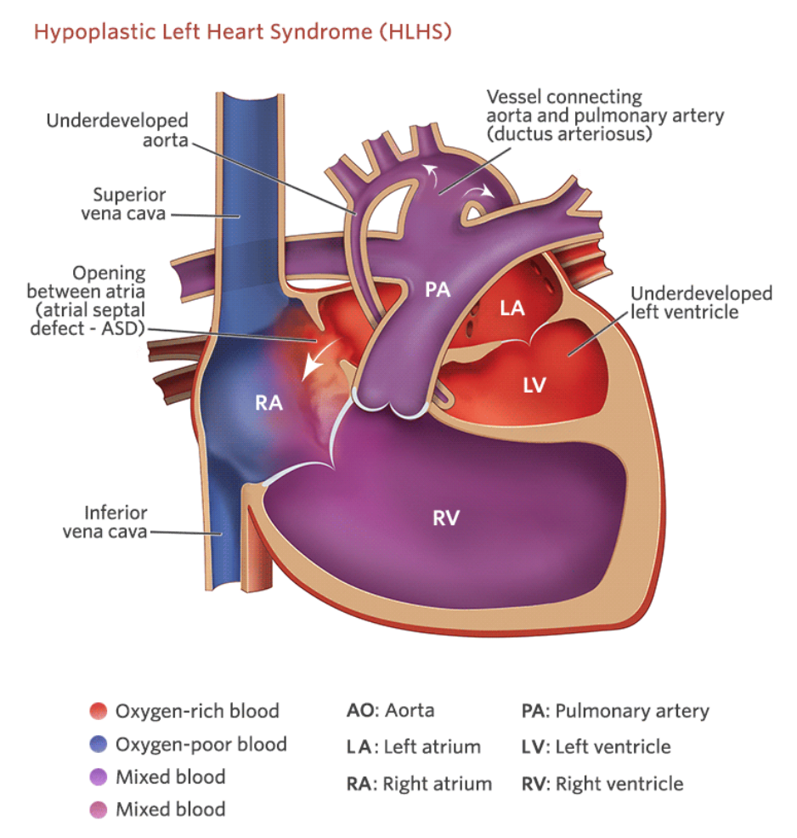
Notes:
Hypoplastic Left Heart Syndrome is a severe congenital heart defect in which the left side of the heart is underdeveloped.

Slide 3
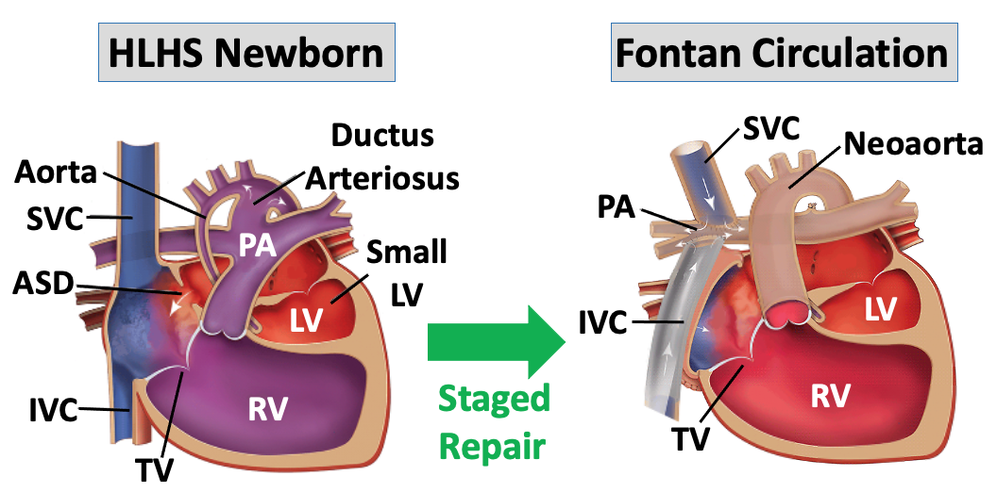
Notes:
Through staged pallation children are are able to function with a single functional ventricle, in this case the right ventricle. The tricuspid valve is the atrioventricular valve for the right ventricle which prevents backflow of blood when the ventricle contracts. But over time this valve can fail and require repair.

Slide 4
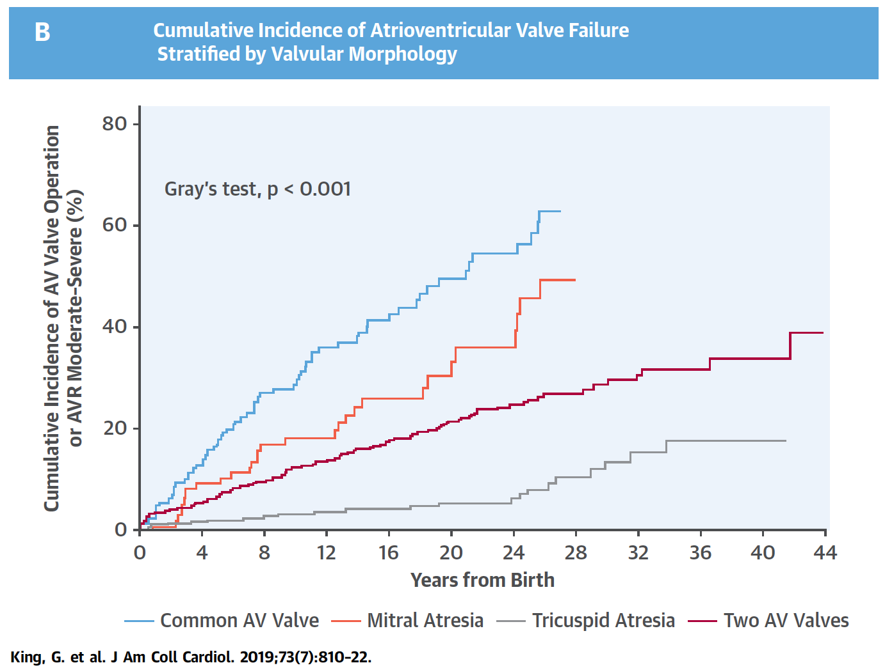
HLHS
Notes:
A recent study demonstrated that up to ¼ of valves fail by age 16, and nearly 50% before age 30.

Slide 5
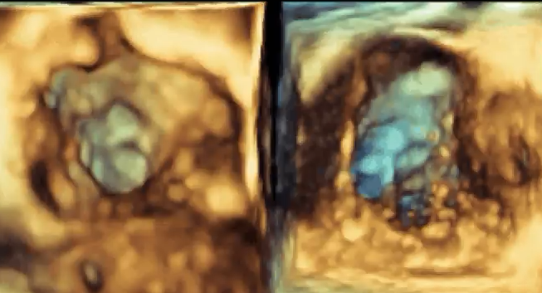
RA View
RV View
Notes:
3D echocardiography can help us visualize the valve in 3D

Slide 6
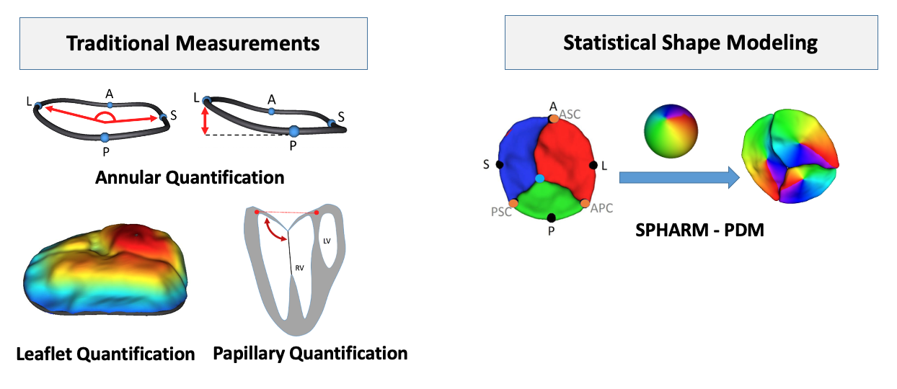
Notes:
But in order to understand the association of structure to function it is essential to quantify the characteristics of the valve, which requires segmentation.

Slide 7
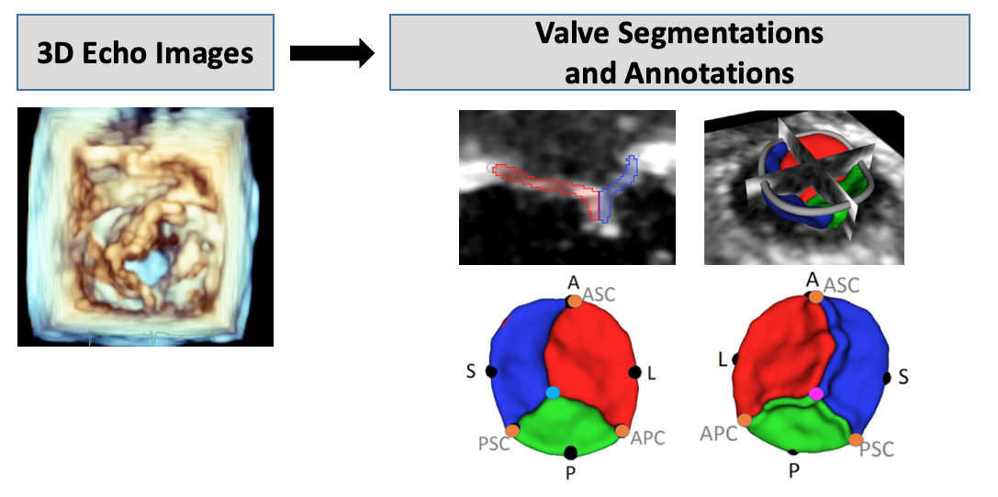
Notes:
Right now segmentation and annotation is performed by skills research assistants who take 3-4 months to become independent with this task. And each valve can still take 3-4 hours to accurately segment with manual tools.

Slide 8
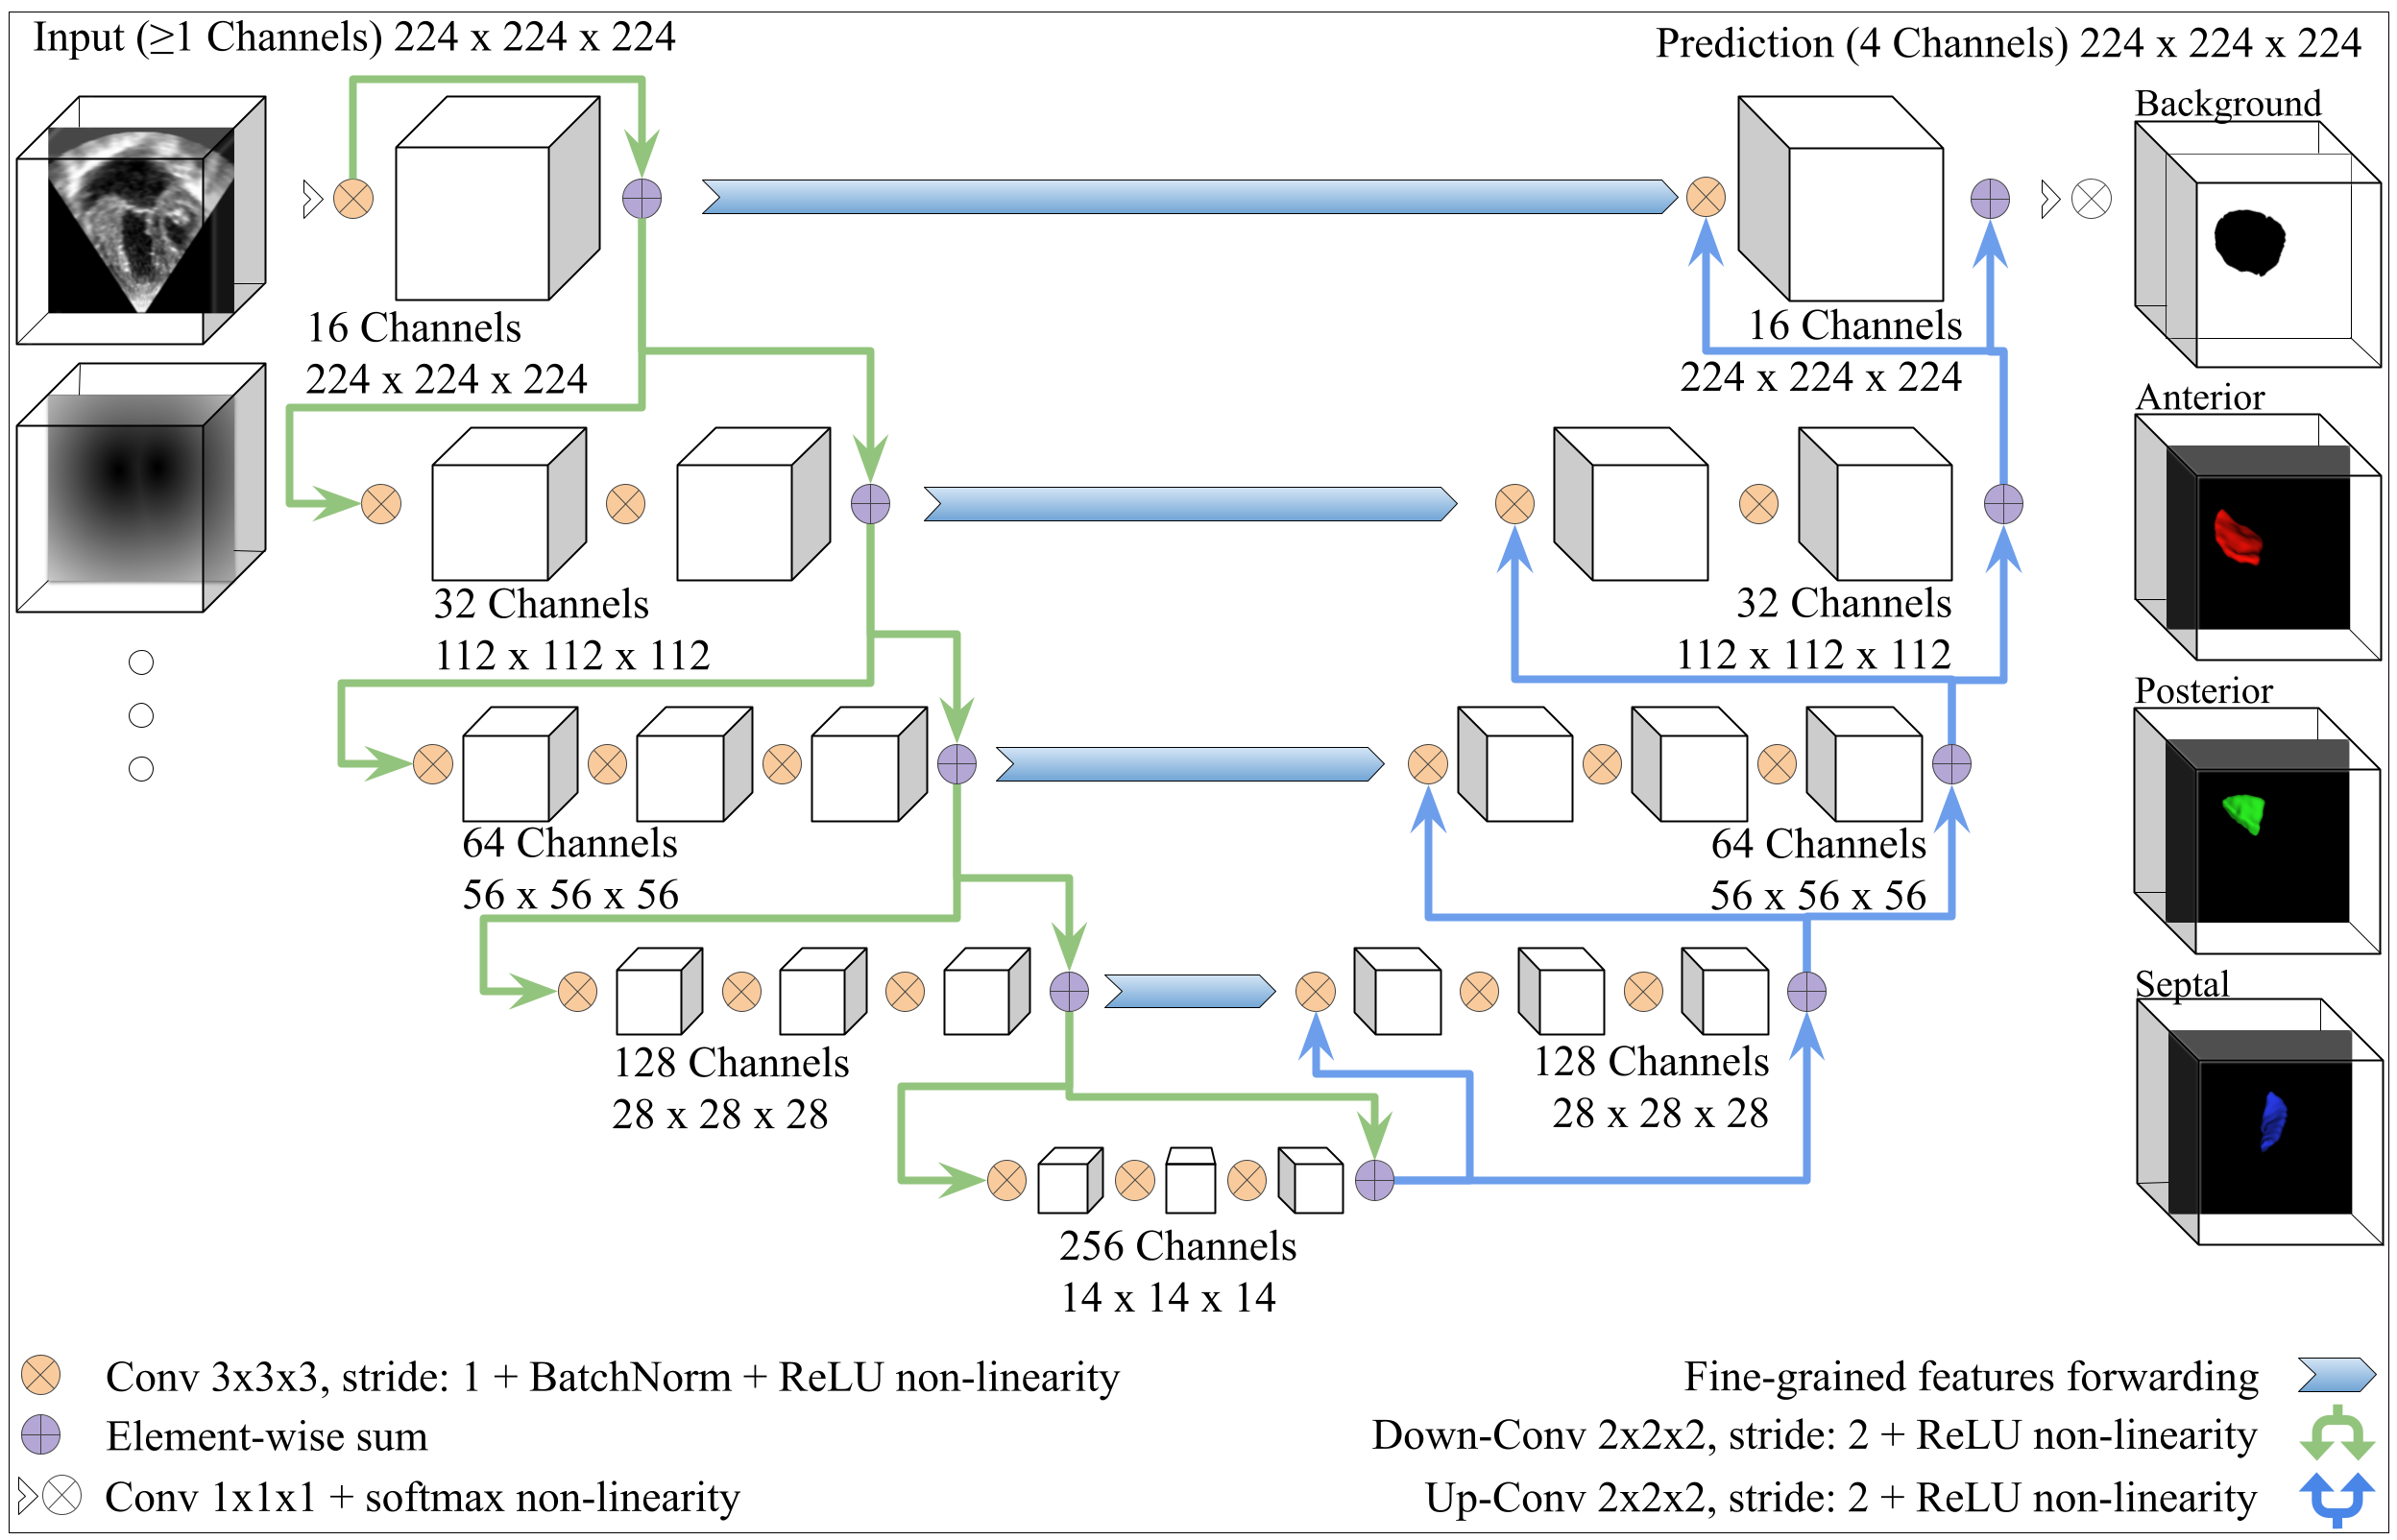
Notes:
As such we have been working on a deep learning based approach to this and have a functional V-net based model.

Slide 9
https://github.com/JolleyLabCHOP/DeepHeart
Notes:
We are now working to deploy this model on a server for general use by converting our custom code to MONAI, and deploying the model in MONAI Label.

Slide 10
More Background on HLHS
https://www.chop.edu/conditions-diseases/hypoplastic-left-heart-syndrome-hlhs
https://www.chop.edu/treatments/staged-reconstruction-heart-surgery

